Slide 1

Wormhole
Lite-paper

Slide 2
WormDex
Worm Swap - Gasless transactions in Ethereum and Binance Smart Chain networks.
Worm Portfolio – Hyper personalized dashboard to track one’s portfolio in Ethereum and Binance Smart chain network.
Worm Stake – Staking platform for your $wormhole to get rewards and make transactions free of cost.
Worm Information Center - Information about all Wormhole verified new releases.
Worm Launchpad – A Launchpad to launch only KYCed projects.
Worm Contract - Upgradable smart contract Generator.
Worm Rent – A unique marketplace to lend gaming NFTs for leading gaming projects.

Slide 3
Roadmap
Phase 1 ‘22 Q1
Worm Swap
Worm Stake
Phase 2 ‘22 Q2
Worm Portfolio
Phase 3 ‘22 Q3
Worm Launchpad
Worm Information Center
Worm contract generator
Phase 4 ’23 Q1
Worm Rent

Slide 4
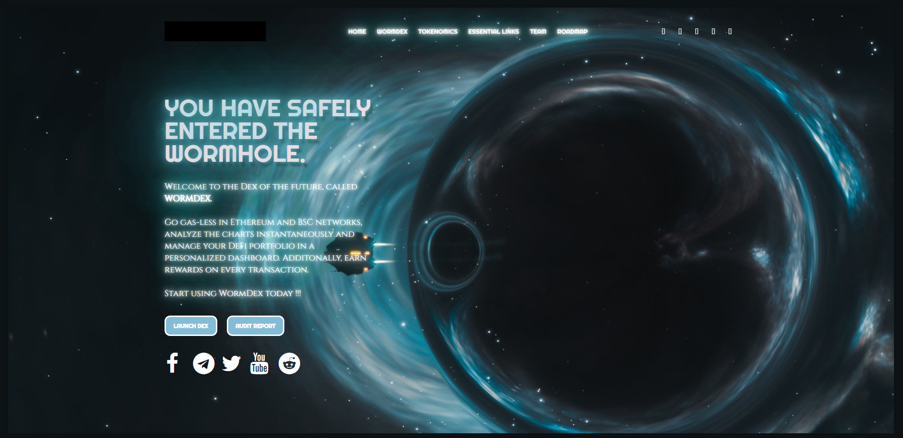
Website

Slide 5
Reference projects
https://www.swaptracker.io/
https://uniswap.org/
https://www.binance.com/en
https://pancakeswap.finance/
https://pinksale.com/
https://www.epsilon.gold/
https://cowswap.exchange/#/swap

